Slide 1





Slide 2

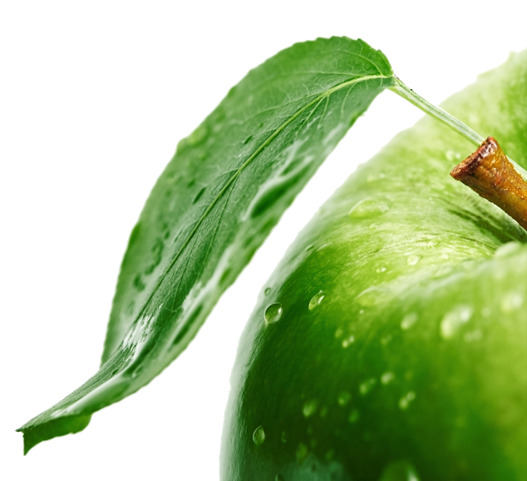
/CONTENTS
Company Profile
Founder Profile
Mibelle Profile
Product & Clinical Test
Marketing Plan
Galery
Testimoni
Philippines Stockies :
Makati 2F Oriental Gardens Makati
Chino Roces Ave. Makati 1200

Slide 3


Biogreen believes that every health problem nowadays spread all over the world as the increasing number of pollutant, less nutritious food, stress, as well as the inability of our bodies to constantly cleanse ourselves from all the toxins that can ultimately jeopardize our health‭.‬
With the continuing decline in health conditions around the world, Biogreen Science believes that everyone should start implementing lifestyle can rejuvenate and nourish the body so they can maintain a decent standard of living in good health and optimal fit‭.‬
For the sake of spreading the good things to the world‭, ‬Biogreen Science awares that each person only needs to open their eyes to the fact‭.‬
Larry Widjaja and his partner combining network marketing success legendary along with extensive experience in the field of nutrition their unyielding spirit to continue to make Biogreen Science as a health company and fitness No‭. ‬1‭ ‬in Indonesia‭.‬

Slide 4

Now in 8‭ ‬months‭, ‬from more than 10,000‭ ‬members have joined in this mission‭. ‬Biogreen Science mission is to create the millions of people who are healthier and creating a sustainable source of income with Integrity and Heart‭.‬
You just pave the way towards a brighter future with a whole the ability you have this moment with partner companies, in order to realize the aspiration to change the conditions of health and welfare of the world for the better. Everything starts from you‭ .‬We are honored you have decided to join us‭.‬
^{welcome‭.}
^{Larry‭ ‬}

Slide 5
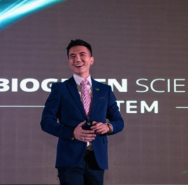
^{ABOUT THE FOUNDER}
The meteoric rise of Biogreen Science was piloted by the visionary founder with a charitable heart, Larry Widjaja.
His inspirational story is one that’s worthy of mention time and again.
Life back then was not easy but at the age of 15, Larry started various kinds of business; from selling cigarettes to mobile phone credits.
Due to his enterprising nature and trustworthiness, he quickly built a vast network and could even draw a higher paycheck than his school’s headmaster.
In just a spate of few years, Larry’s business empires continue to prosper at amazing rate.

Slide 6

Now, he already has 8 companies in various portfolios such as property, entertainment and movie industries. He strongly believes that health industry is an enormous one; if done through network marketing concept, the potential is unbelieveable.
Biogreen Science definitely have all the ingredients for immense success. With top quality products to match its profitable marketing plan, a strong financial footing and broad connections around the world, we are on our journey to be a top notch company in the international world of network marketing

Slide 7
“
^{Vision}
If there’s a phrase “Network Marketing” that ever be heard or run by someone on earth, then the company must be biogreen science.
^{Mision}
MisionBioGreen Science is committed to create millions of opportunity and create a sustainable source of income with Integrity and Heart.
“

Slide 8
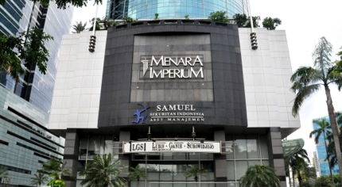
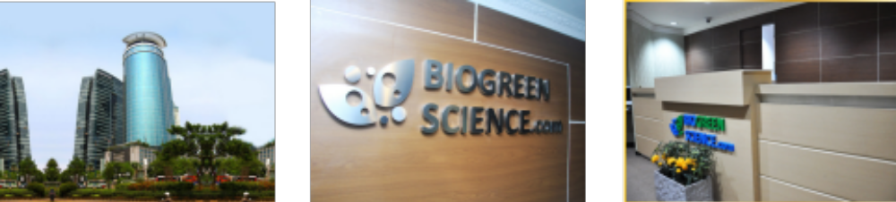
^{BIOGREEN OFFICE}

Slide 9

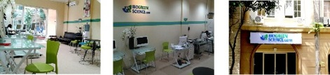
^{BIOGREEN OFFICE}

Slide 10

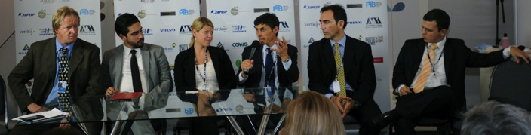
Currently, the Mibelle Group, a full-service brand manufacturer customer, serve three business units: Personal Care, Home Care and Nutrition. With Mibelle Group Brands business unit, is also active in the development and management of exclusive brands in the cosmetics sector. As an independent business unit operations, Mibelle Biochemistry Group is specialized in the research and development of active ingredients for cosmetic applications and has an outstanding reputation in the cosmetics industry worldwide. The Mibelle Group is number three in the European market owned brands.
The Group has approximately 1,000 employees and generated sales of around
^{EUR 328 million.}

Slide 11
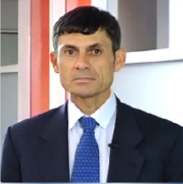
ABOUT Dr.Fred Zull
The man who is really instrumental in Mibelle Biochemistry Switzerland and Biogreen Science, Dr.Fred Zull.
He was the founder and Inventor of Apple Stemcell and was awarded 2008
European Cosmetic Innovation Prize.
Dr.Fred Zulli Studying and Receiving Phd Biochemistry and ETH Zurich. He was then working at the Nestle Research Center in Switzerland on food, before he Entering the cosmetics industry. Dr.Fred Zulli is the Founder and Chief Mibelle Biochemistry, A 20 year-old Swiss company, Special Moves in Innovation Research and Development of Active Ingredients for Cosmetic Industry.

Slide 12
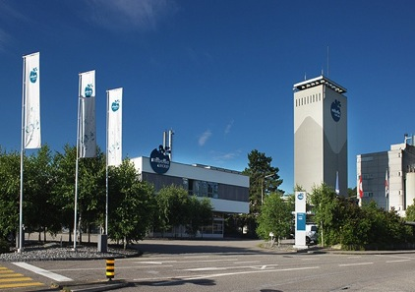
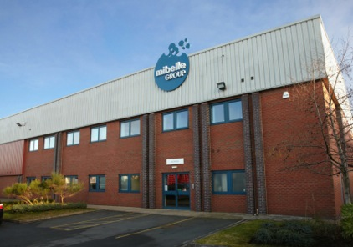

Slide 13
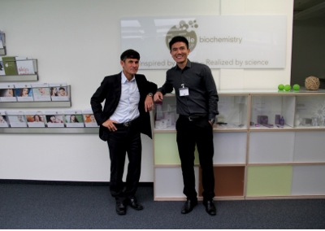
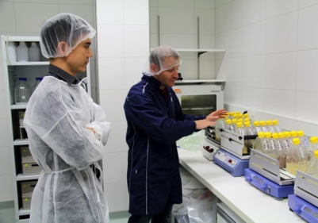

Slide 14

^{MIBELLE BIOCHEMISTRY AWARDS}
Seven time innovation prize winner:
European Cosmetics Innovation Prize 2008, category : Best Active Ingredient
Innovation Zone Best Ingredient Award in-Cosmetics Europe 2012
Innovation Zone Best Ingredient Award in-Cosmetics Asia 2012
^{BSB Innovation Prize 2012}
CPCIA Personal Care Ingredients 2012
European Cosmetics Innovation Prize 2014, category : Best Active Ingredient
Frost & Sullivan 2014 Best Practices Award

Slide 15
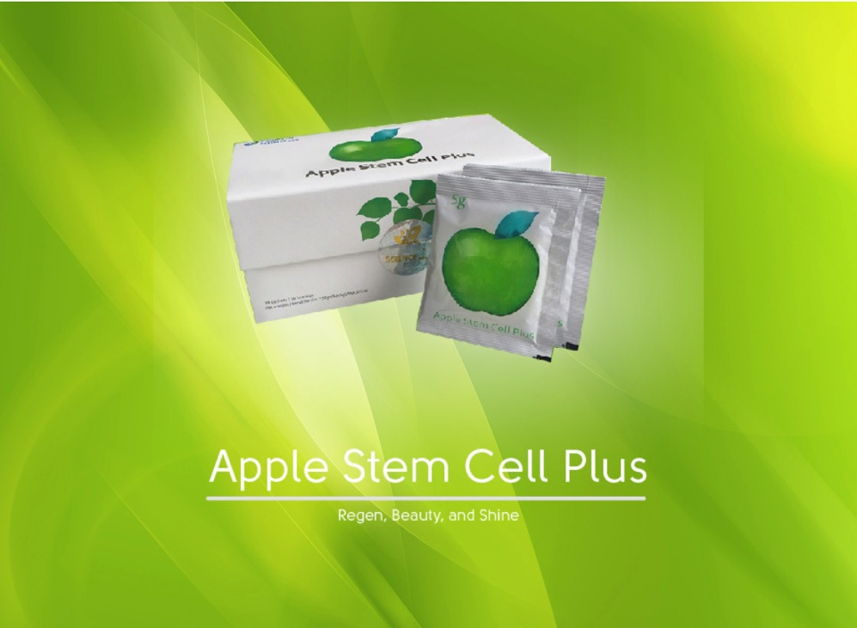

Slide 16

^{AGING}
^{Why this is happened ‭?‬}

Slide 17
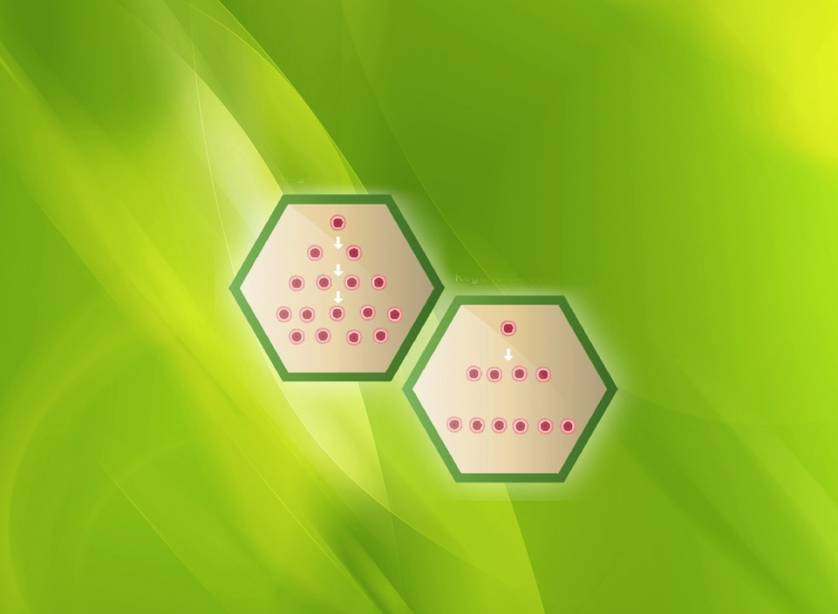
The Decrease of Cells Qualitatively and Quantitatively
^{Young Cell Regeneration}
^{Old Cell Regeneration}

Slide 18

^{Stem Cell}
^{Characteristic‭ :‬}
^{Self Renewal‭:‬}
Stem Cell could go through some division cycles to maintain its amount
^{Differentiation‭ :‬}
Capacity to form as specific cell for restoration and replace the broken cells and build new cells
There are two kinds of stem cells in human body‭:‬
^{Embyronic Stem Cell}
^{Adult Stem Cell}

Slide 19
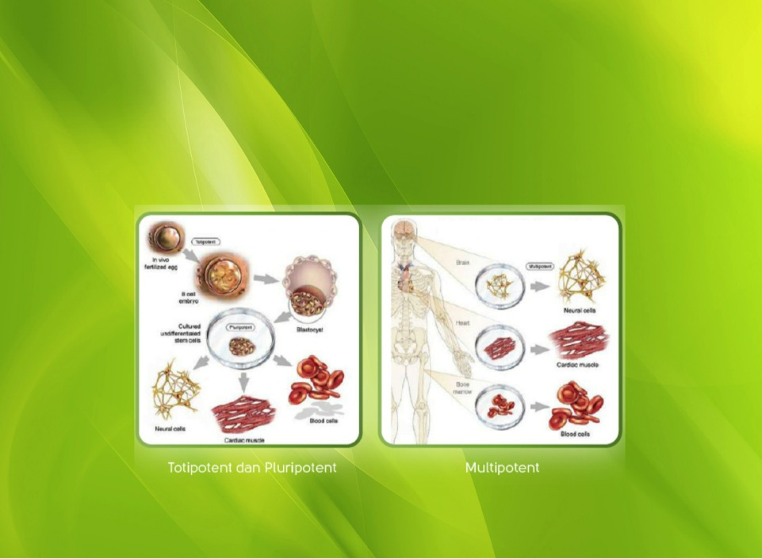
^{Stemcell}
^{Adult Stemcell}
^{Embrionic Stemcell}

Slide 20


How about stem cells on the plants‭?‬
The benefits of plants in regenerating‭:‬
Forming callus to regenerate‭,‬
All plants have potencies to form this callus
^{BUT HOW MUCH?}

Slide 21
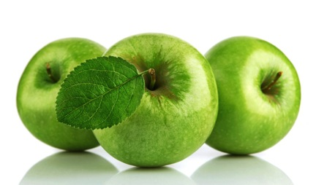
^{Uttwiler Spatlauber Apple}
^{(Malus Domestica)}
This apple has cultivated in 18th century‭, ‬But has been forgotten because its sour and bitter taste‭.
^{Becomes a rare type of Apple}
This apple can preserve its freshness for one year‭.‬
Inspire Dr‭. ‬Fred Zuelli to observe and develop this kind of apple‭.‬
He developed and patented with the name PhytoCellTec. ™
‮

Slide 22
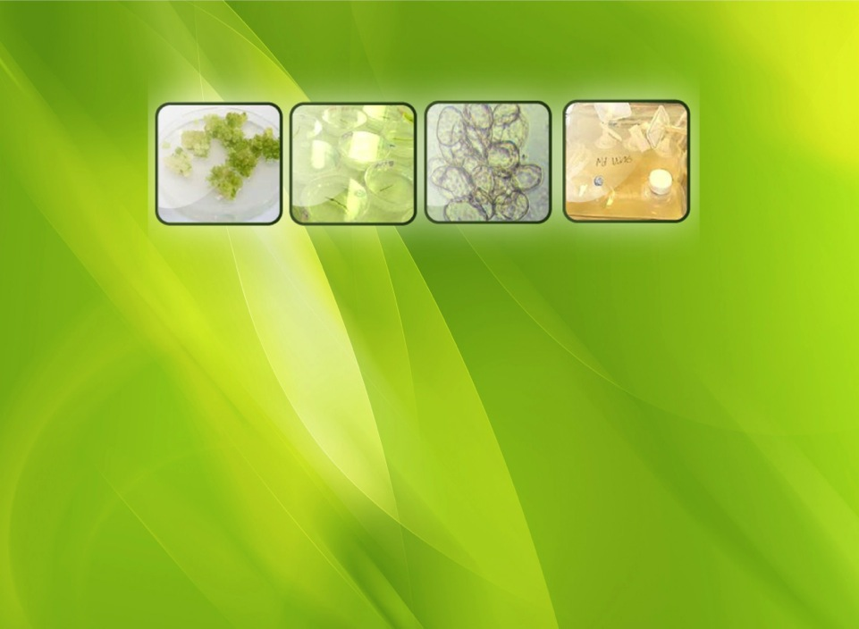
PhytoCellTec ™(Malus Domestica)
Harvesting extract of Stem Cells by making wound on the
Apple to form new Callus tissues.
This callus has the same characteristic with Stem Cells, then be cultivated and bred.
NOT USING growth hormone, dangerous chemicals even genetic engineering!

Slide 23
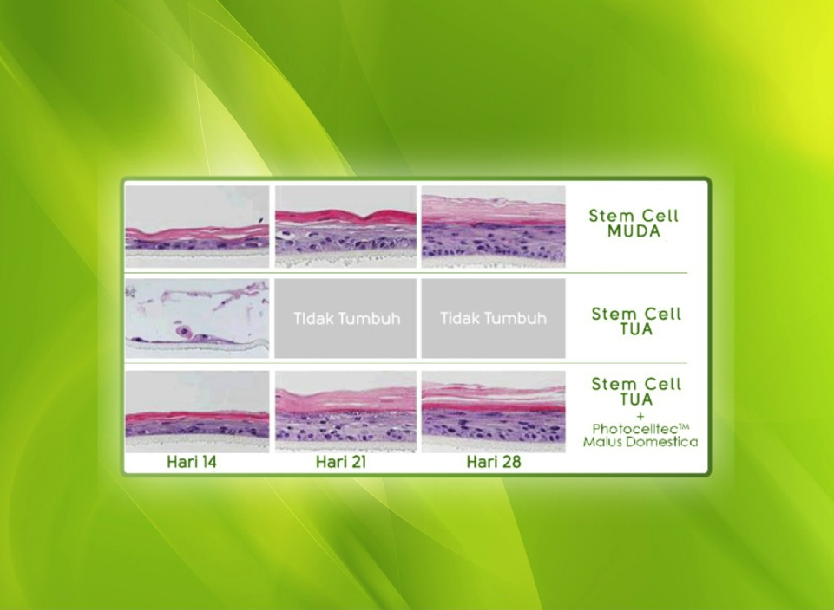
^{Skin Cells Regeneration}

Slide 24
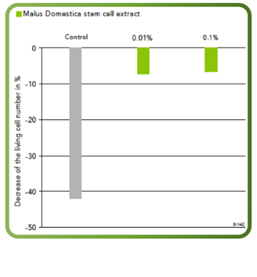
^{Preventing skin cells from UV}

Slide 25
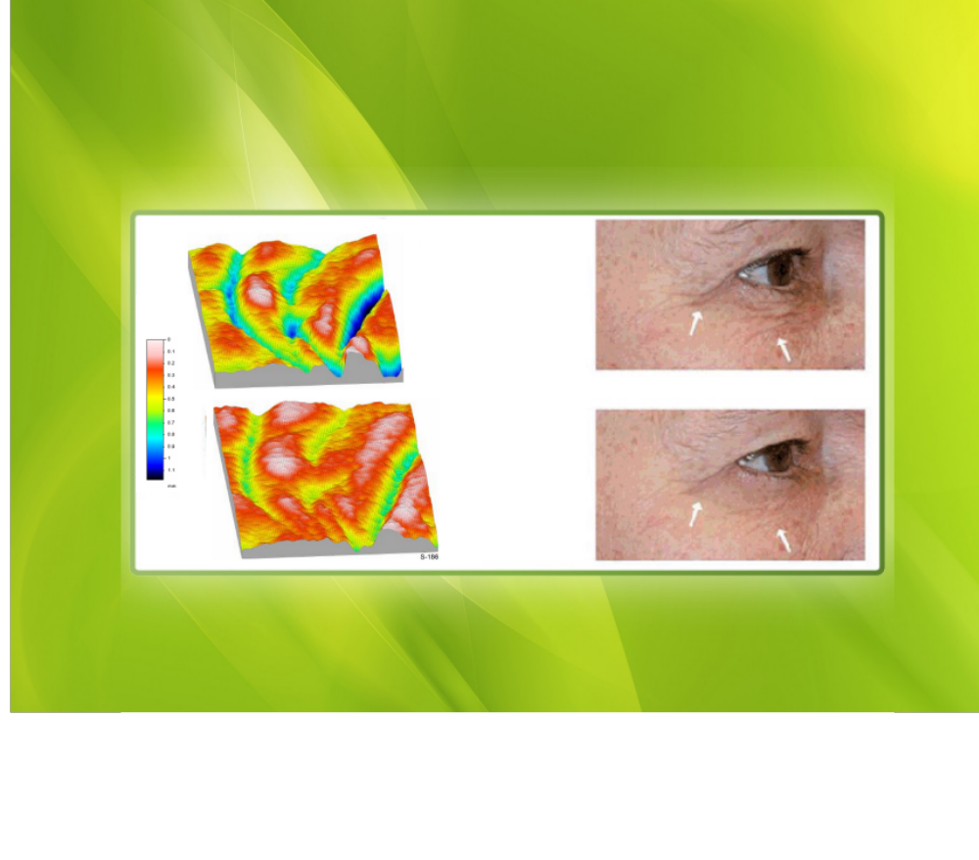

^{Reducing Wrinkles}
^{Day 0}
^{Day 28}
^{2% PCT Malus}
^{Domestica}

Slide 26
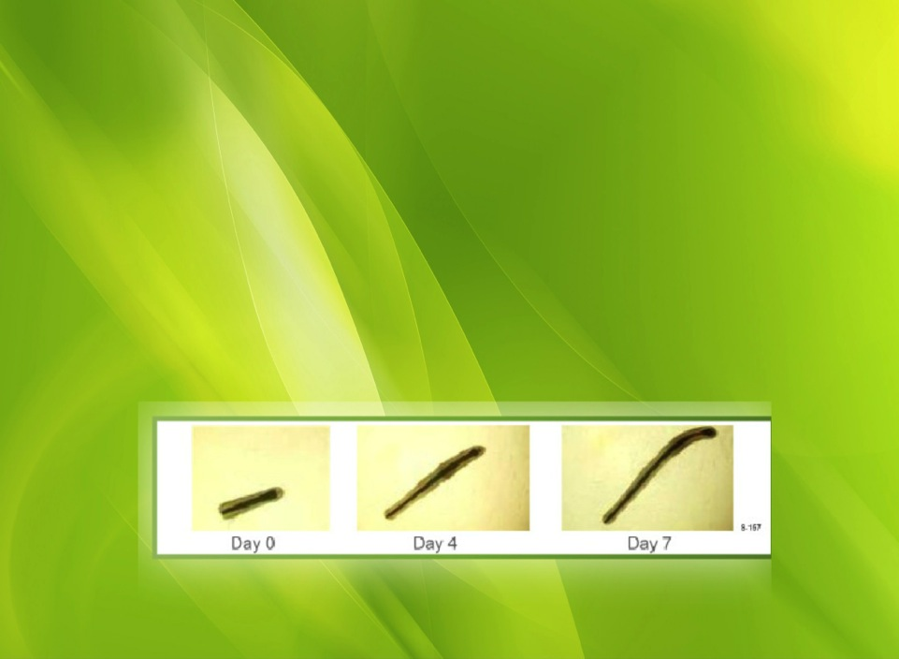
^{Clinical Test on Hair}
^{Hair Follicles}
^{: From human skin fragments}
^{(From micro dissection)}
^{Test substance}
: PhytoCellTec™ Malus Domestica 0.2%
^{Design}
: Length of hair follicle increases until day 14
>after day 14 induction of senescence
>length of hair follicle decreases

Slide 27
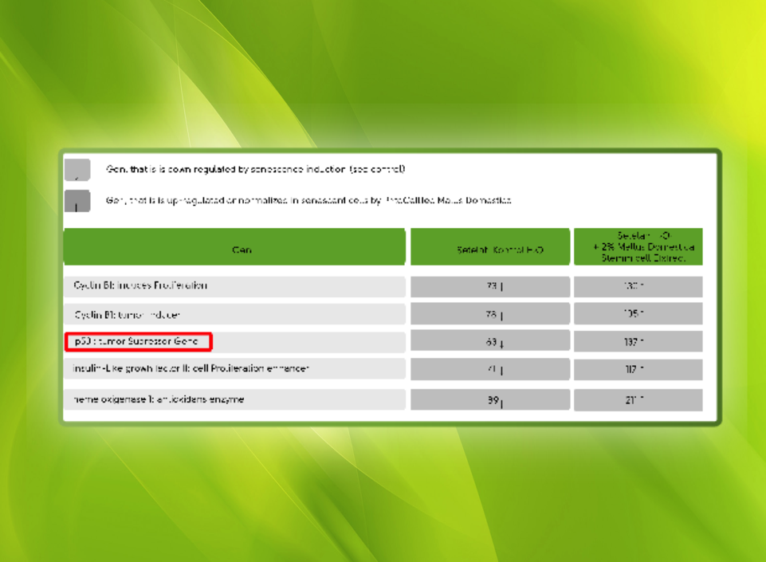
Clinical Test of Apple Stem Cell Plus
Help normalizing broken cells and preventing CANCER‭.‬

Slide 28
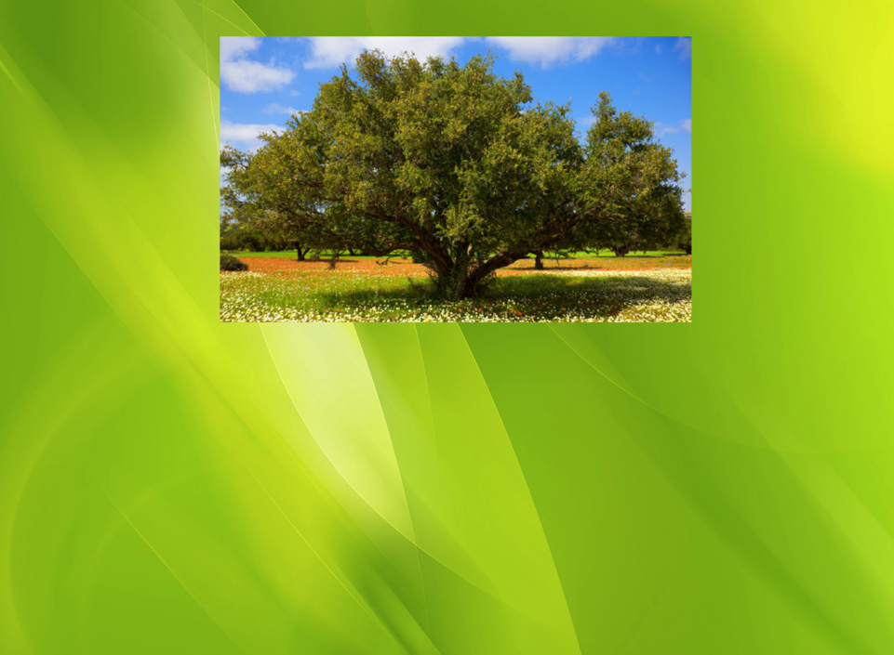
^{Argan tree}
^{‭(‬Argania spinosa‭)‬}
Argan Tree could last for 150‭ ‬to 200‭ ‬years in‭ extreme environment‭ ^{‭(>‬50º‭)‬}
Include as one of the plants that have the longest life span‭.‬
The fruits are peanut-like shaped with diameter 3cm

Slide 29
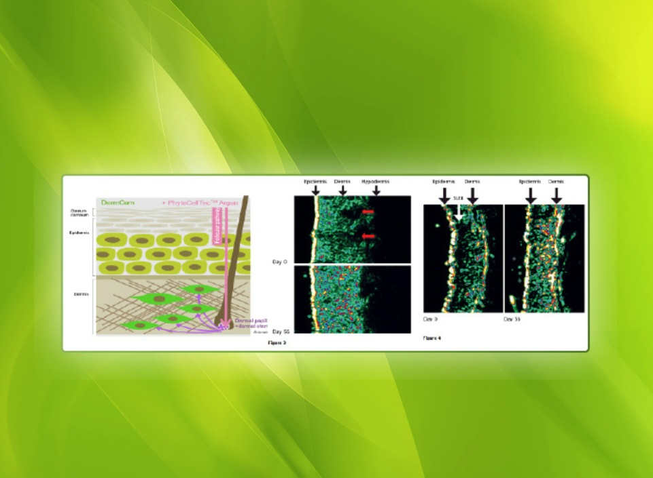
^{Argan Tree}
Help regenerating fibroblast cells
Repairing extracellular structure‭ - ‬Reducing‭ ‬the wrinkles’‭ ‬depth
Fibroblast functioned to produce collagen and elastin in skin’s dermis and bind collagen and elastin‭.‬

Slide 30
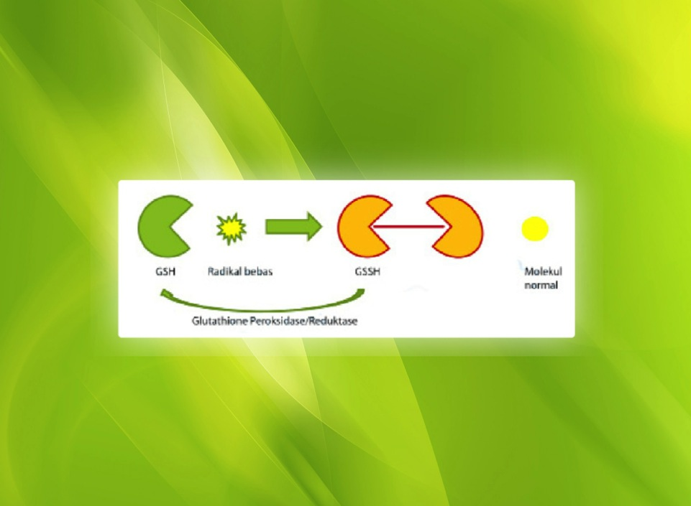
^{Glutathione}
One of the most important Antioxidant in plants‭, ‬mushrooms‭, ‬
^{animal and human‭. ‬}
Preventing damage caused by Free radicals‭!‬
^{‭Antioxidant}
- ‬Anti-aging and anti-wrinkles
‭- ‬Makes skin smooth‭, ‬fresh and radiant
^{‭- ‬Enchance healing wounds}
^{‭Melanin Inhibition}
^{- ‬Whitens the skin}
^{‭- ‬Dark Spot remover}
^{-Prevent and/or remove}
^{Pimples and‭ pomple marks}
‬

Slide 31
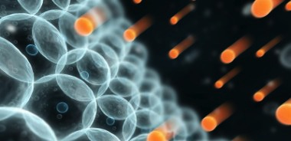
^{What is free radical‭?‬}
Free radical is a labil molecule that really reactive‭.‬
Free Radical is like a criminal that lack of energy‭.‬
Free Radical attacks from the inside energy to satisfy‭ ‬
^{themselves‭.‬}

Slide 32
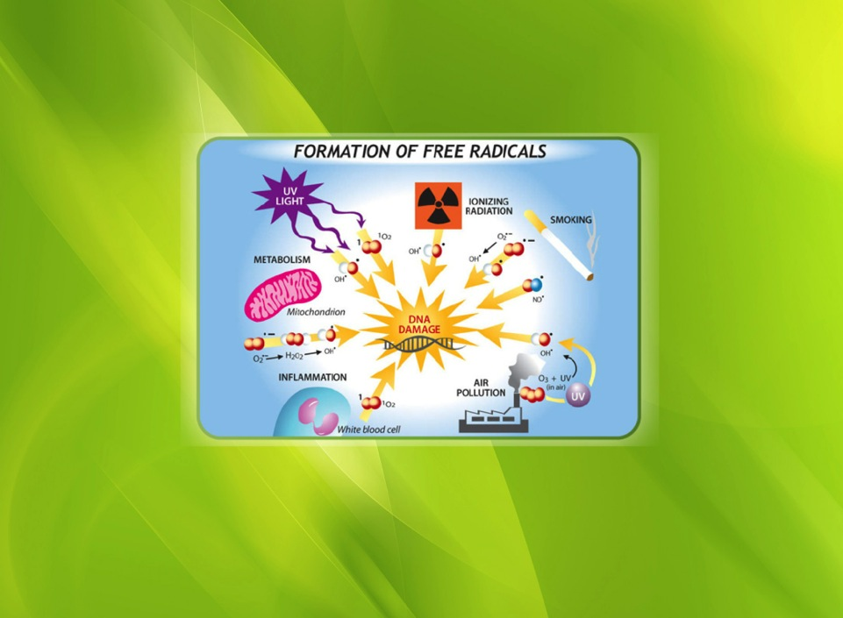
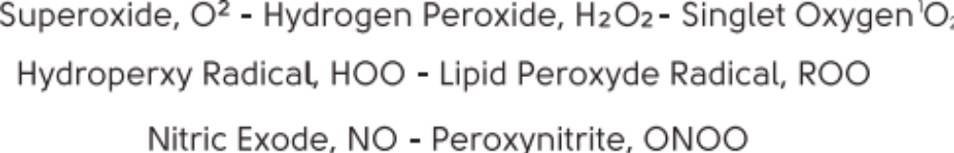
^{Where is FREE RADICAL from‭?‬}
^{FREE RADICAL FORMATION}

Slide 33
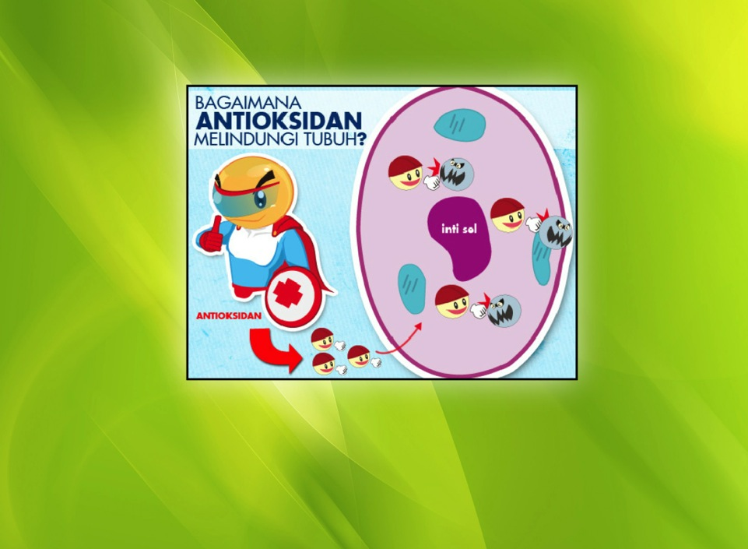
How can we solve free radical‭?‬
The hero of our body against free radicals is
^{ANTIOXIDANT}
Antioxidant will neutralize free radicals by setting up electron so free radicals will be stable and not reactive anymore‭.‬

Slide 34
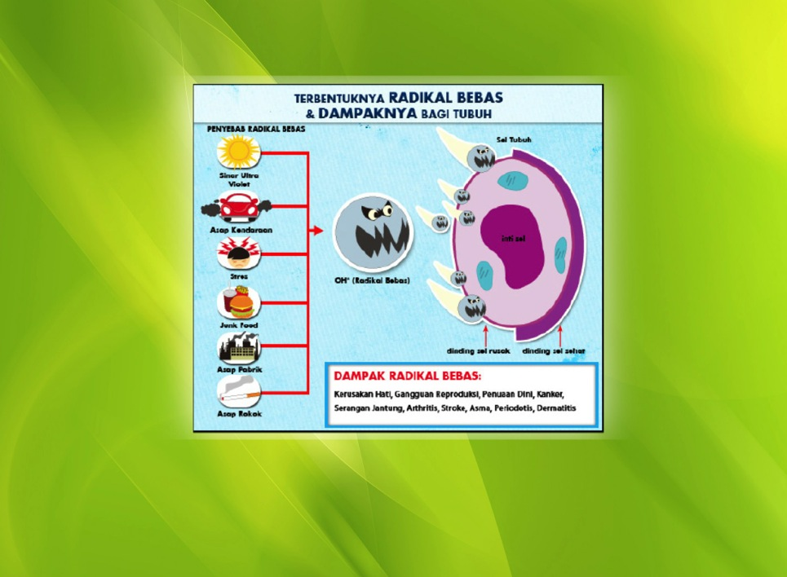
^{The impact of free radicals}
‭ - ‬Liver damage‭ - ‬Reproductive disorders‭ - ‬Premature Aging
‭- ‬Cancer‭ - ‬Heart Attack‭ - ‬Arthritis‭ - ‬Stroke‭ - ‬Asthma
^{‭- ‬Perioditis‭ - ‬Dermatitis}

Slide 35
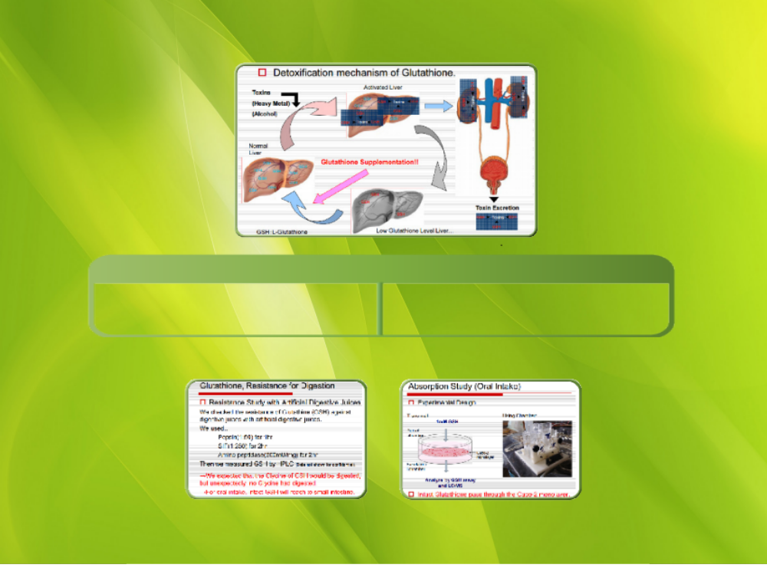
The way of glutathione as anti-toxic
The biggest problem of glutathione
Broken down by stomach acid that resulted missing its active form.
Does not penetrate the intestinal cells that resulting waste
Clinical test for Glutathione solving the problems

Slide 36

^{Kohjin’s L-Glutathione is‭:‬}
‭ ‬US FDA GRAS Notice‭ (#‬GRN 000293‭)‬
^{‭ ‬KOSHER Certified by‭ ‬“OK”}
^{‭ ‬HALAL Certified by‭ ‬“MUI”}
‭ (‬For Muslims such as Indonesia‭, ‬Malaysia‭, ‬MiddleEast‭)‬
‭ ‬Fermented from FDA approved Yeast‭ (‬Tortula Yeast‭)‬
‭ ‬No adverse report on drug compatibility
^{Kohjin is‭ :‬}
Leading manufacturer of glutathione since 1968
^{‭ ‬ISO Certified/GMP approved}

Slide 37
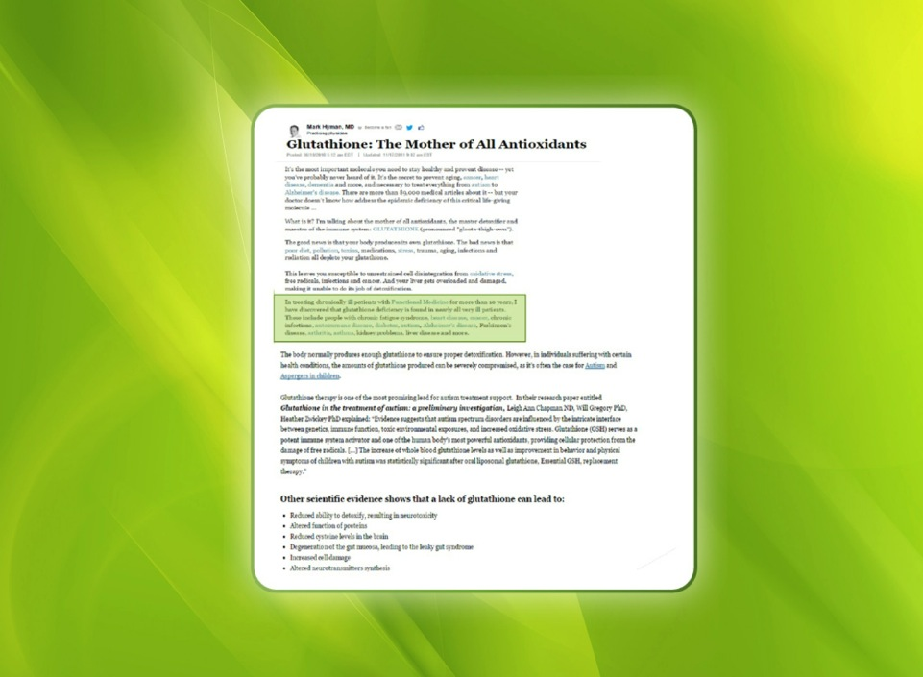
^{The Benefits of Glutathione}

Slide 38
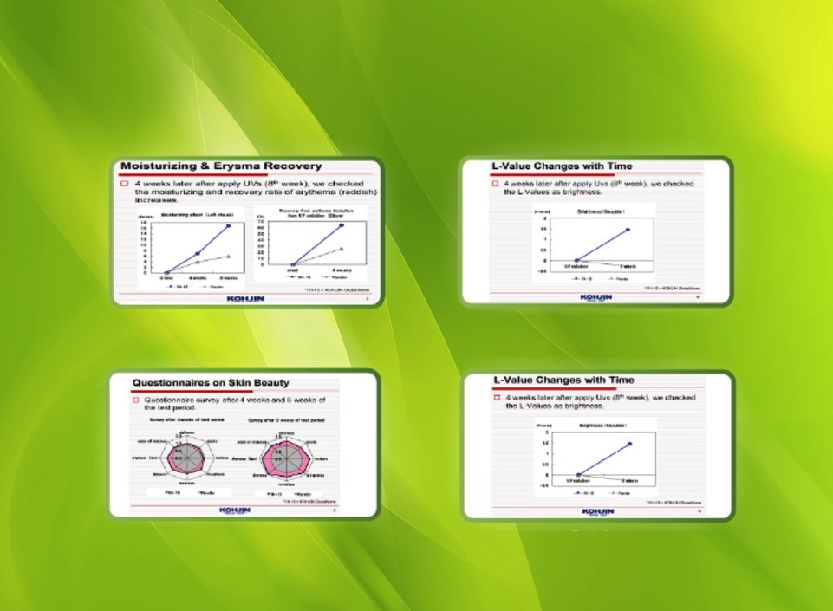
^{The Benefits of Glutathione}
^{Help recovering}
^{Brighten skin}
^{Repairing skin quality}
^{Detox}

Slide 39

^{AWARD}
Mibelle Group’s award and partnership certificates between Biogreen Science and Mibelle Biochemistry
Those photos above are the proofs that Mibelle Biochemistry got so many awards and have cooperated with Biogreen Science.

Slide 40
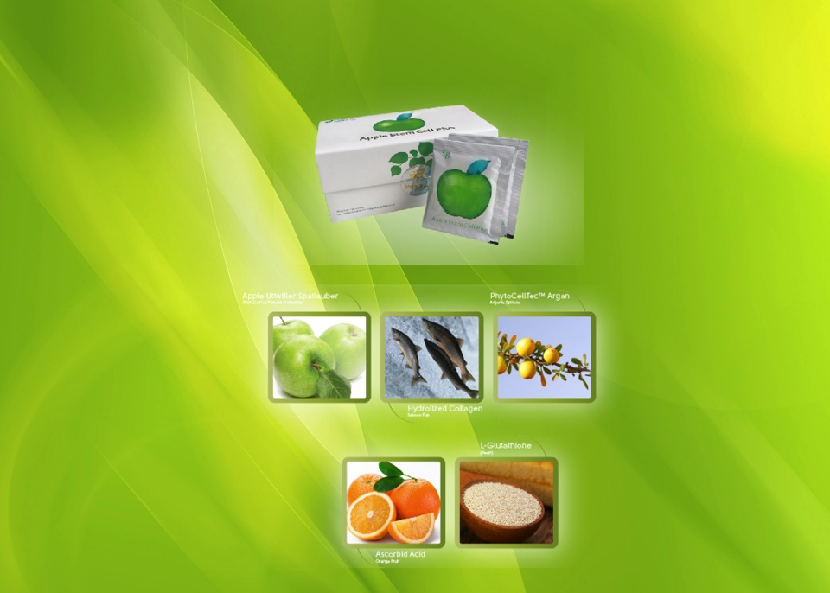
^{Ingredients}

Slide 41

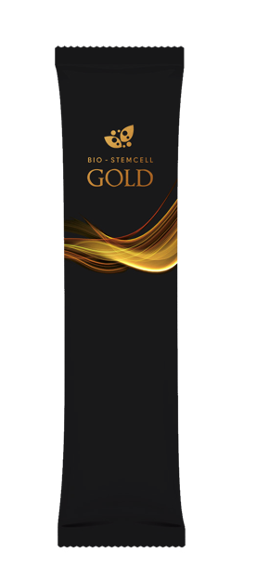

Slide 42

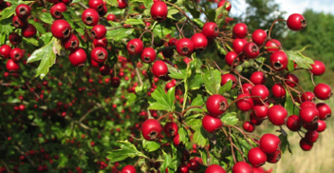
^{Miracle Herb : Ashwagandha}
^{(Withania Samnifera)}
Ashwagandha is herbal plants that has been used in ancient Indian with Ayur Veda holy book.
Strong adaptogen function which can return the stability. (Homeostatis)
Ashwagandha KSM -66
What are the advantages
of KSM - 66 :
- All active components are integrated.
- Active component: Standard withanolide
above 5%
- Has its own land so 100% organic
- Does not smell bad
- Chemicals FREE
- GRAS certified!
- Alcohol Free
- NON GMP, Halal and Vegetarian certified

Slide 43
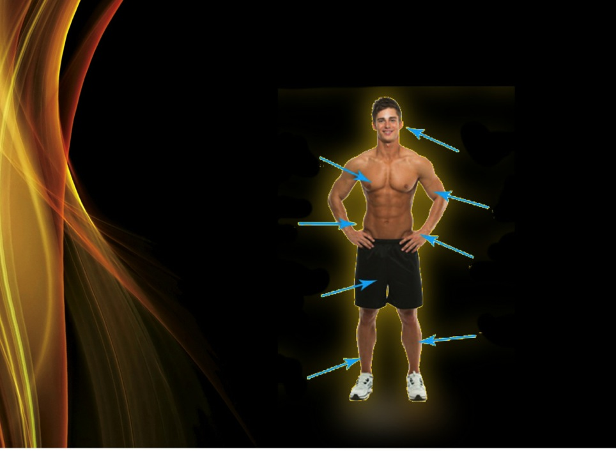
WHY YOU NEED more TESTOTERONE ?
Part of bodies that influenced by Testosterone
^{SKIN}
^{BRAIN}
^{MUSCLE}
^{LEVER}
^{KIDNEY}
^{MALE SEXUAL}
^{ORGANS}
^{BONE}
^{MARROW}
^{BONE}

Slide 44
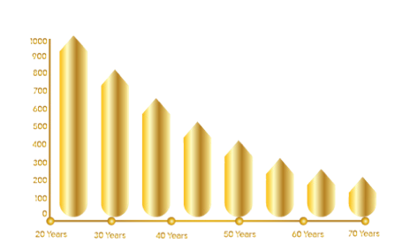
DEFLATION OF TESTOSTERONE WILL IMPACT :
^{- The decline of fertility}
^{- Reduction of sexual drive}
^{- Disfunction in erection}
^{- Hair fall}
^{- Reduction of muscle mass}
^{- Accumulation of fat}
^{- Osteoporosis}
^{- Sleep Distraction}
^{- Mood Swing}
^{- Prematurity}

Slide 45

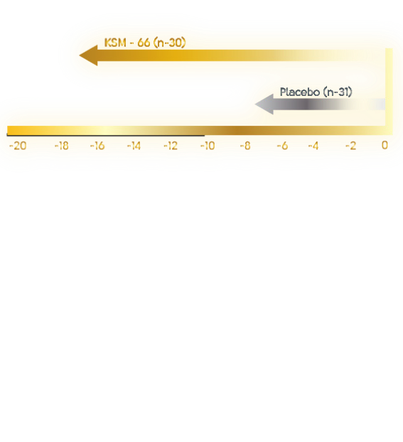
^{ANTI STRESS}
Proven in lowering kortisol hormone

Slide 46
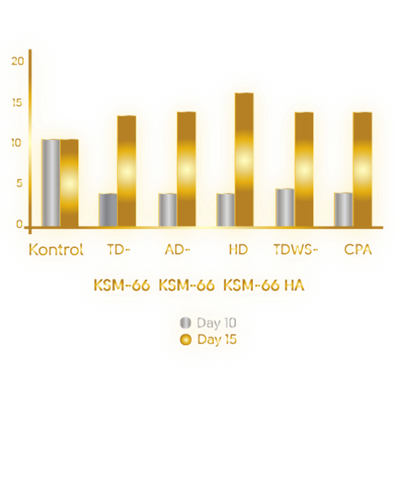
^{IMMUNE - MODULATION :}
INCREASE IMMUNE INFLUENCE ON WBC

Slide 47
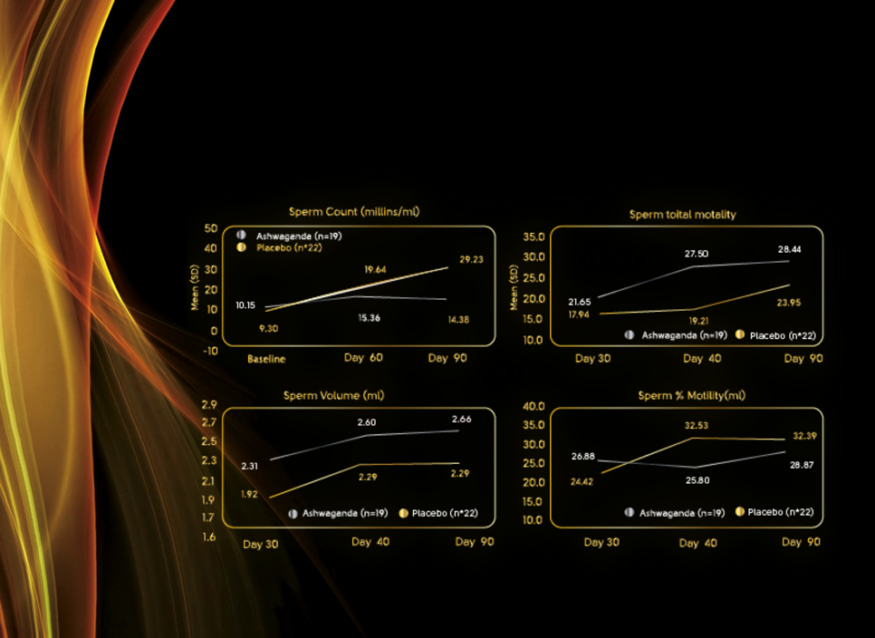
_{ANTI-BARREN :}
REPAIRING QUALITY AND QUANTITY OF SPERM

Slide 48
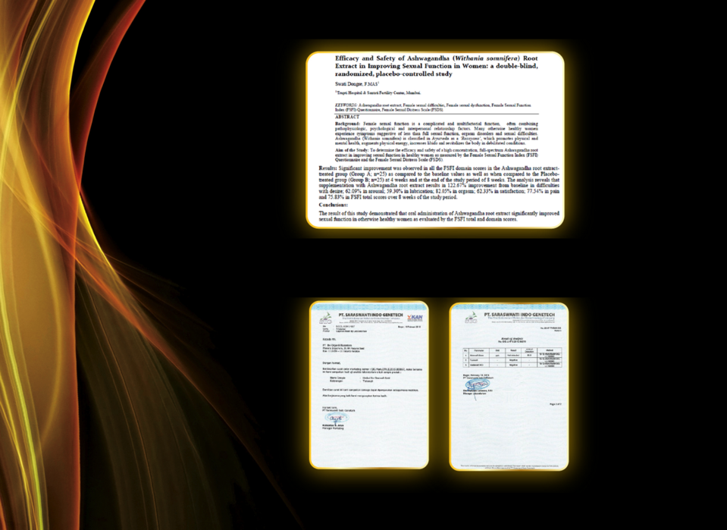
REPAIRING WOMEN’S REPRODUCTION
LABORATORY’S TEST FOR ASHWAGANDHA

Slide 49
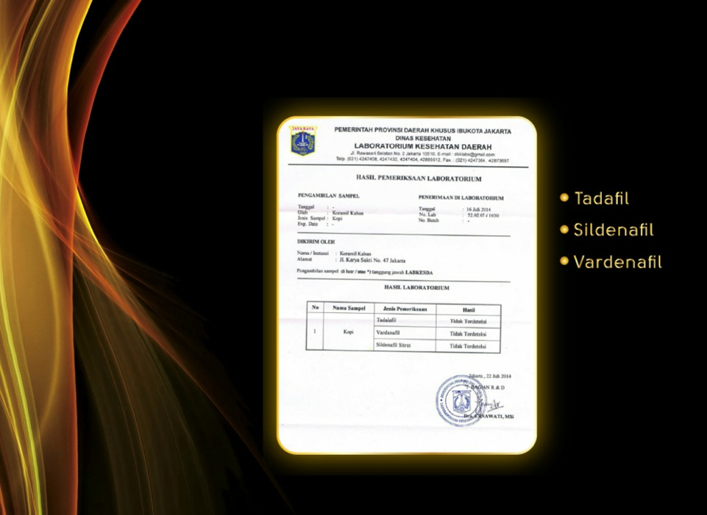
AUTHENTIC PROOF FROM THE GOVERNMENT THAT STATES BIOGREEN SCIENCE’S PRODUCTS ARE FREE FROM :

Slide 50
ANOTHER FUNCTION OF ASHWAGANDHA
Ashwagandha contains many useful medicinal chemicals, including withanolides (streroidal lactones), alkaloids, choline, fatty acids, amino acids, and a variety of sugars. While the leaves and fruit have valuable therapeutic properties, the root of the Ashwagandha plant is the part most commonly used in Western herbal remedies.
^{- Protects the immune system}
- Helps combat the effects of stress
- Improves learning, memory, and reaction time
- Reduces anxiety and depression without causing drownsiness
- Helps reduce brain-cell degeneration
^{- Stabilizes blood sugar.}
^{- Helps lower cholesterol}
- Offers anti-inflammatory benefits
- Contains anti-malaria properties
- Enhances sexual potency for both men and women

Slide 51
^{FUNCTION OF ASHWAGANDHA :}
Studies Suggest Potent Anti-Cancer Activity
In addition to ashwagandha’s documented neuroprotective effects, exciting recent evidence suggests that it also has the potential to stop cancer cells in their tracks. For example, a recent analysis showed that ashwagandha extract inhibited the growth of human breast, lung, and colon cancer cell lines in the laboratory. This inhibition was comparable to that achieved with the common cancer chemotherapy drug doxorubicin (Caelyx®, Myocet®). In fact, researchers reported that withaferin A,
a specific compound extracted from ashwagandha, was more effective than doxorubicin in inhibiting breast and colon cancer cell growth.
Scientists in India recently conducted cell studies showing that ashwagandha extract disrupts cancer cells’ ability to reproduce—a key step in fighting cancer. Additionally, laboratory analysis indicates that ashwagandha extract possesses anti-angiogenic activity, also known as the ability to prevent cancer from forming new blood vessels to support its unbridled growth. These findings lend further support to ashwagandha’s potential role in fighting cancer. Based on these studies, research in this area continues.

Slide 52
In another study, orally administered ashwagandha extract significantly inhibited experimentally induced stomach cancer in laboratory animals. Tumor incidence was reduced by 60% and tumor multiplicity (number) by 92%. Similarly, in a rodent model of skin cancer, ashwagandha inhibited tumor incidence and multiplicity by 45% and 71%, respectively.16Ashwagandha’s protective effect against skin cancer has been shown in other studies as well.17
A recent experiment demonstrated that ashwagandha extract produced a marked increase in life span and a decrease in tumor weight in animals with experimentally induced cancer of the lymphatic system.18 This is an exciting finding, suggesting that ashwagandha could enhance survival in individuals with cancer.

Slide 53
The past year has been banner year for Ashwagandha research. Numerous studies confirmed its healing properties in a variety of conditions, including stress, toxicity, heart disease, Alzheimer’s disease, diabetes, Parkinson’s, skin cancer, tuberculosis, liver toxicity and many others. Following is a summary of some of the findings of the over fifty different human, laboratory and animal studies conducted using Ashwaghanda published during 2012 and early 2013:
- Research from the Asha Hospital in Hyderbad found, in a study of 64 people withchronic stress, that Ashwagandha supplementation for two months decreased stress by 44% and decreased depression and/or anxiety by 72%.
-Tokyo University of Technology researchers found that Ashwagandha slows the process of melanocyte stem cell phosphorylation, giving it the potential of blocking skin cancers.

Slide 54
Banasthali University researchers found that Ashwagandha may protect the liver against lead toxicity.
Jamia Hamdard University researchers found that Ashwagandha reduces oxidative damage related to brain cell damage – making it useful for reducing dementia andAlzheimer’s risk.
Eight weeks of Ashwagandha supplementation increased endurance, respiration capacity and metabolic efficiency among cycling athletes, according to research from Guru Nanak Dev University.
Research from Texas’ Baylor University found that Ashwagandha
reduced inflammation related to type I diabetes.
Research from the College of Pharmacy at University of Hawaii performed assays that found that Ashwagandha inhibited
cancer-related cytokines.

Slide 55
^{FUNCTION OF ASHWAGANDHA :}
Researchers from the Indian Institute of Technology found that
Ashwagandha compounds inhibited proteins involved in
Leishmaniasis.
Researchers from Jamia Hamdard University’s Pharmacy Faculty found that Ashwagandha reduces oxidative stress related to type 2 diabetes.
Researchers from the Defence Institute of Physiology and Allied Sciences found that Ashwagandha supported memory and helped prevent nerve cell degenerationamong rats.
Colorado State University researchers found that Ashwagandha and other Ayurvedic herbs help protect the heart from oxidative damage.
Researchers from Malaysia’s University Sains found that Ashwagandha reduced fatigue and increased general well-being among patients who were undergoing chemotherapy.

Slide 56
Researchers from the Chonbuk National University in the Republic of Korea found that Ashwagandha reduced populations of Streptococcus mutans and Streptococcus sobrinus – oral bacteria known to be at primary agents of tooth decay andperiodontal disease.
Researchers from Pakistan’s Quaid-i-Azam University found that Ashwagandha inhibited cancer cells from growing.
Research from India’s National Research Institute of Ayurvedic Drug Development found that Ashwagandha combined with other Ayurvedic herbs reduced symptoms among tuberculosis patients.
Researchers from the ICMR Advanced Centre for Reverse Pharmacology in Traditional Medicine found in a 30-day clinical trial among 18 healthy volunteers that 750-1250 milligrams of Ashwagandha per day reduced cholesterol, improved sleepand increased muscle strength.
Researchers from Louisiana State University found that Ashwagandha inhibitedcancer tumor growth.

Slide 57
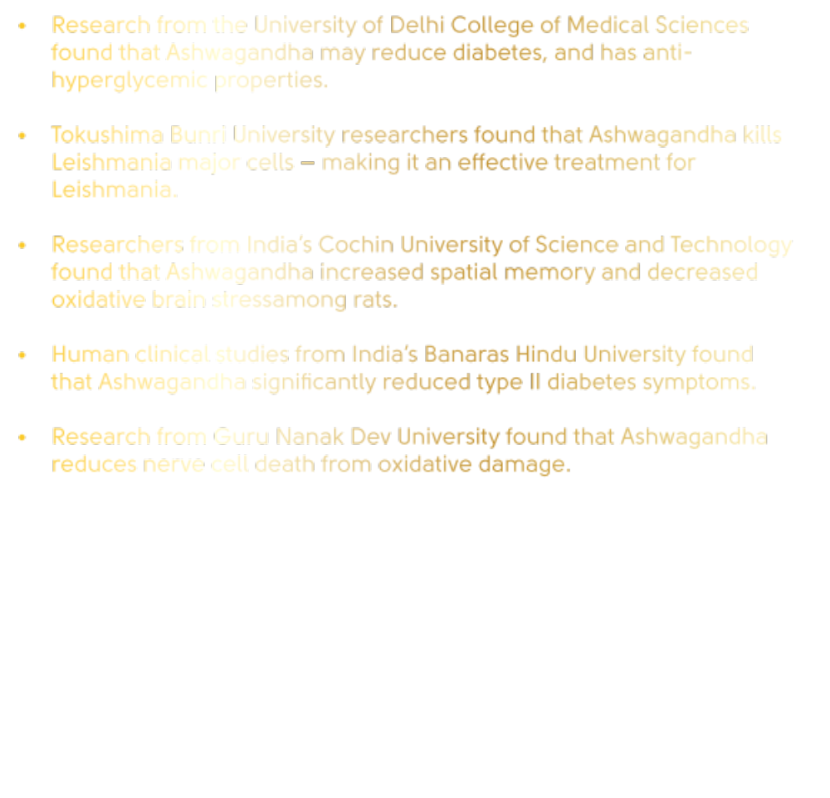
_{FUNCTION OF ASHWAGANDHA :}
Researchers from India’s Central Food Technological Research Institute found Ashwagandha was antioxidant and inhibited oxidative brain cell damage and reversing mechanisms related to Parkinson’s disease.
Researchers from India’s Central Drug Research Institute found that coagulanolide from Ashwagandha increased glucose tolerance and decreased fasting blood glucose among mice.
Research from the Ayurvedic Hospital in Ahmedabad found that Ashwagandha with an herbal combination called Rasayana significantly reduced coughing, fever and other symptoms among tuberculosis patients.
Researchers from Malaysia’s Universiti Sains medical school found that Ashwagandha inhibits several pathogenic bacteria, especially Salmonella.
Research from India’s Bankura Sammilani Medical College found that Ashwagandha may treat depression.

Slide 58
Research from Germany’s University of Tuebingen discovered that Ashwagandhareduces oxidative stress and alters gene expression to help cells with energy production.
Researchers from Brooklyn’s Woodhull Medical Center found that Ashwagandha increases circulating cortisol levels and improves insulin sensitivity. This effect was also found for those with adrenal insufficiency issues or even congenital adrenal hyperplasia – a birth defect of the adrenal glands.
Studies from South Korea’s Keimyung University found that Ashwagandha inhibits tumor growth and stimulates the killing of renal cancer cells.
Research from the University of Pittsburgh Cancer Institute and the University of Pittsburgh School of Medicine found that Ashwagandha inhibits breast cancer cell migration
Researchers from Detroit’s Wayne State University found that Ashwagandha suppresses the growth of mesothelioma, a lung disease most prominently associated with asbestos toxicity.
Research from Saudi Arabia’s King Abdulaziz University found that Ashwagandha helps protect the heart and cardiovascular system from oxidative radicals.

Slide 59
_{FUNCTION OF ASHWAGANDHA :}
Research from the University of Delhi College of Medical Sciences found that Ashwagandha may reduce diabetes, and has anti-hyperglycemic properties.
Tokushima Bunri University researchers found that Ashwagandha kills Leishmania major cells – making it an effective treatment for Leishmania.
Researchers from India’s Cochin University of Science and Technology found that Ashwagandha increased spatial memory and decreased oxidative brain stressamong rats.
Human clinical studies from India’s Banaras Hindu University found that Ashwagandha significantly reduced type II diabetes symptoms.
Research from Guru Nanak Dev University found that Ashwagandha reduces nerve cell death from oxidative damage.

Slide 60
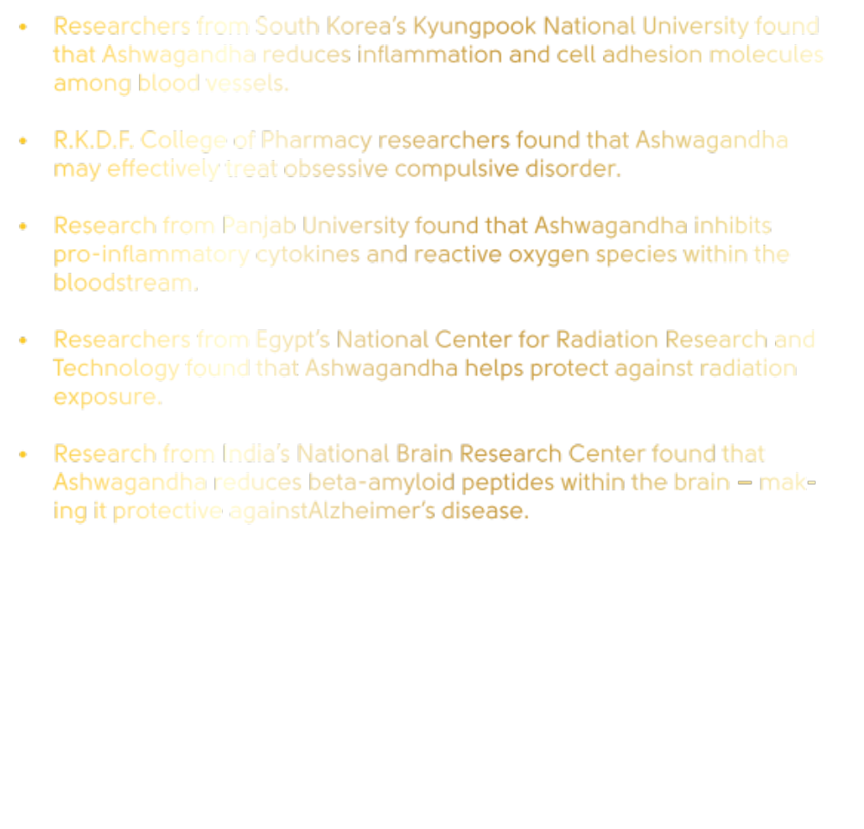
Researchers from South Korea’s Kyungpook National University found that Ashwagandha reduces inflammation and cell adhesion molecules among blood vessels.
R.K.D.F. College of Pharmacy researchers found that Ashwagandha may effectively treat obsessive compulsive disorder.
Research from Panjab University found that Ashwagandha inhibits pro-inflammatory cytokines and reactive oxygen species within the bloodstream.
Researchers from Egypt’s National Center for Radiation Research and Technology found that Ashwagandha helps protect against radiation exposure.
Research from India’s National Brain Research Center found that Ashwagandha reduces beta-amyloid peptides within the brain – making it protective againstAlzheimer’s disease.

Slide 61
_{FUNCTION OF ASHWAGANDHA :}
Ashwagandha (Withania somnifera) contains a myriad of constituents, including withanolides named withanolide A, withanolide B, withaferin A, and withanone, along with 12-deoxy withastramonolide, withanoside V, withanoside IV. Other complex molecules include trihydroxy-oxowitha-trienolide compounds. These have been found to act synergistically to enable changes in gene expression within the cell – producing a variety of medicinal effects in addition to antioxidant effects. While some research is striving to isolate and extract that one constituent to be synthetically produced in a lab to make a patented drug, the research above and others over the past year testify that this Ayurvedic powerhouse herb is best used in its whole or whole extract form.

Slide 62

INGREDIENTS
Reducing stress and anxiety, Increasing Memory and Cognition, Increasing Muscle Strength, Increasing Endurance, Repairing quality for a restorative sleep, Increasing sperm mobility and quality, Controlling body weight, Boosting immune system
^{Apple Uttwiler Spatlauber}
(PhytoCellTec™ Mallus Domestica)
^{Ashwagandha}
^{KSM -66}
^{KOREAN}
^{GINSENG}

Slide 63
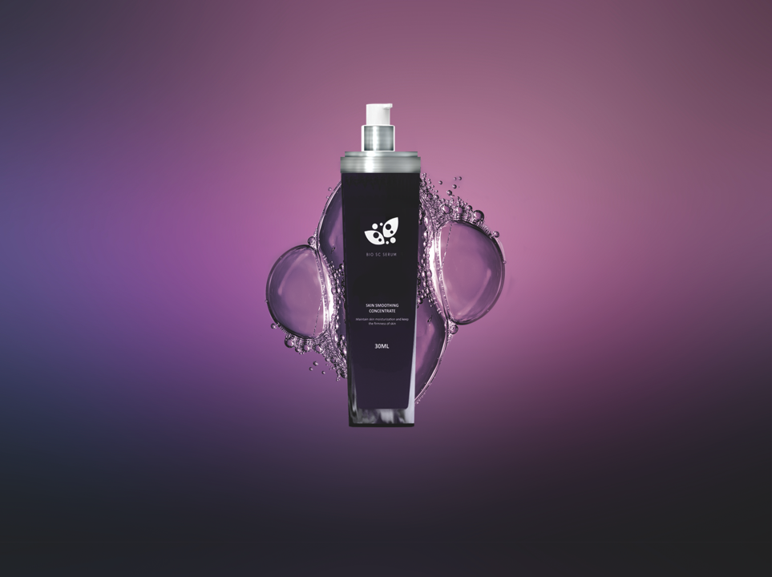
^{BIO SC SERUM}
^{SKIN SMOOTHING CONCENRATE}

Slide 64

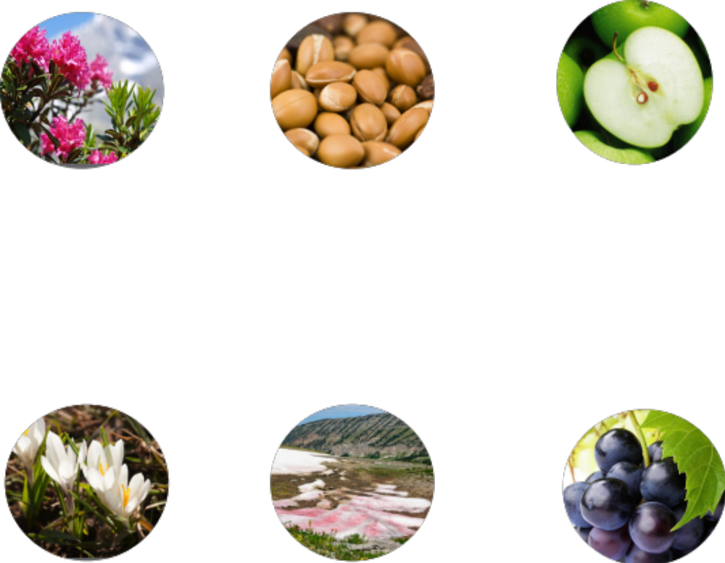
^{BEST ACTIVE INGREDIENTS}
^{PhytoCellTec™}
^{Alp Rose}
^{PhytoCellTec™}
^{Argan}
^{PhytoCellTec™}
^{Malus Domestica}
^{DermCom}
^{Snow Algae}
^{Powder}
^{PhytoCellTec™}
^{Solar Vitis}

Slide 65
THE BENEFITS OF FACE & EYE SERUM
Protects longevity skin stem cells against UV stress‭ ‬
Delays senescence of essential cells
^{Fights photo-aging‭ ‬}
For a vital and healthy-looking skin
^{Combats chronological aging}
Protects against skin protein oxidation
^{Restores skin’s resilience}
^{Reduces herpes occurence}
Protects and activates longevity factors in skin cells
Rejuvenates and protects skin at cellular level
Safeguards skin’s youthfulness by activating Klotho
Strengthens cellular defense mechanisms through calorie restriction mimetic activity‭ ‬
Reinforces‭, ‬smoothes and hydrates the skin

Slide 66
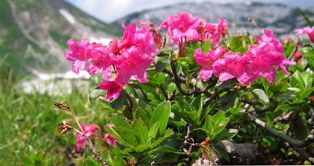
^{Alpine Rose}
^{Rhododendron Ferugineum}
Alpine Alpine Rose‭ (‬Rhododendron Ferugineum‭) ‬is a symbol of Alpine and Swiss Mountains
Has been used from a long time ago as a cure of arthritis‭, ‬rheumatism etc‭.‬
Alpine Rose can live in extreme condition‭: ‬Cold‭, ‬sun rays and dry‭.‬
PROBLEM
RARE
Because of Phytocelltec, this flower can be useful.

Slide 67
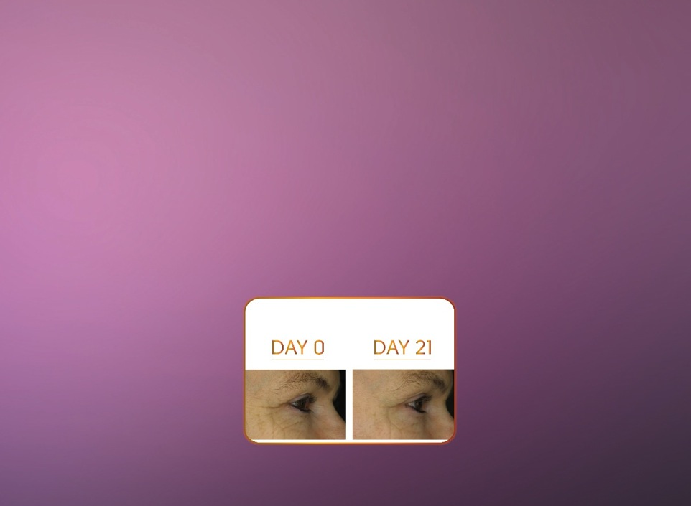
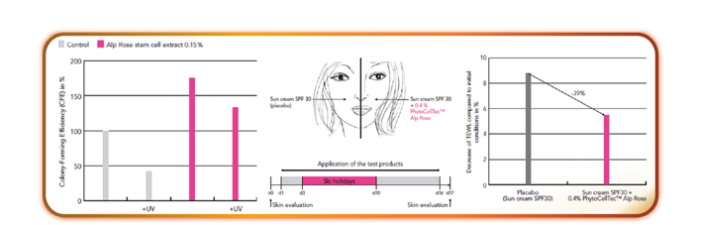
^{Clinical Test of Alpine Rose}
^{increasing Vitality}
^{Skin Stem Cell}
^{Ilustration}
^{Decreasing TEWL}
^{of skin}
Decreasing Wrinkles on face after 21 days usage

Slide 68
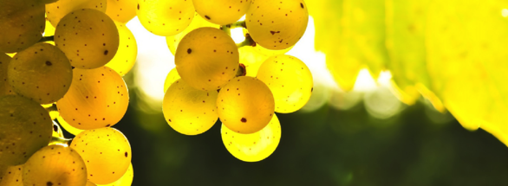
^{Solar Vitis}
Varietas Gamay Teinturier Freaux is from Burgundy‭, ‬France‭.‬
^{‭ ‬Highly resistant from UV}
A high anthocyanin‭, ‬EF and secondary metabolite from SC Solar Vitis becomes the most powerful weapon in preventing UVV

Slide 69

^{Solar Vitis’ Benefits}
Double Protection against UV Damage
PhytoCellTec™ Solar Vitis with epigenetic factors from grape preserves the vitality of skin stem cells.
Due to the strong antioxidant power of the Gamay Teinturier Freaux grape. PhytoCellTec™ Solar Vitis protects the skin cells and notably the epidermal stem cells against UV-induced stress

Slide 70

^{The Benefits of Solar Vitis}
^{Skin Stem Cells and UV Stress}
^{Clinical test of Solar Vitis}
^{Increase Activity SC}
^{Epidermal}
^{protect SC from}
^{UV Stress}

Slide 71

^{Snow Algae}
‭ ‬Snow Algae is Algae living in icy land
Keyword‭: ‬Can live in extreme condition‭!‬
Can live in an extreme condition‭, ‬temperature and UV
Extreme Environment‭ : ‬Snow Algae have developed a series of adaptations that are reflected by diverse secondary metabolites
^{Another uniqueness‭:‬}
Changing of color when adapt into something‭.‬

Slide 72

The uniqueness of Snow Algae’s Life Cycle
Green and Red Life Cycle of Snow Algae

Slide 73

^{Snow Algae Production}
^{High Nutrition}
^{Light}
^{Algae are green}
^{(chlorophyll) and}
^{propagate.}
^{Changing the conditions}
^{Nutrients are reduced}
^{Light is strongly increased}
^{Algae produces carotenoids}
^{to protect against light,}
^{cells stop growing.}
^{Harvesting}
Opening of the cell walls, encapsulation of cell fragments and content into liposomes
Spraying on a powder based on maltodextrin

Slide 74

^{How Snow Algae Works}
Mirroring Calori Restriction Die ^{Mechanism}
^{Snow Algae’s Keys:}
^{KLOTHO dan AMPK}

Slide 75


^{Clinical Test of Snow Algae}
^{Collagen Stimulation}
^{Reducing the effects of aging}

Slide 76

^{Repairing skin’s quality}

Slide 77

^{Derm Com}
Flower buds of Crocus Chrysantus
The buds have good nutrition and cosmetic substances inside

Slide 78

Cell to Cell Communication Concept
^{SEND MESSAGE!!}
^{Communication between cell}

Slide 79



^{How Derm Com Works}
^{Clinical Test of Derm Com}

Slide 80

^{Tighten skins}

Slide 81


^{128 $}
^{640 $}
^{1280 $}
^{BIOGREEN PACKAGE MEMBERSHIP}
^{Package Silver : $128}
^{Package Gold : $ 640}
^{Package Platinum : $1280}
No registration Fee | No Annual Fee | Life Time Membership
Exchange Rate :
Sell 50 PESO
Receive 45 PESO

Slide 82



^{30 $}
^{50 $}
^{100 $}
Silver recruits Silver will get Sponsorship Bonus $30
Silver recruits Gold will get Sponsorship Bonus $50
Silver recruits Platinum will get Sponsorship Bonus $100

Slide 83


^{30 $}
^{150 $}
^{200 $}
Gold recruits Silver will get Sponsorship Bonus $30
Gold recruits Gold will get Sponsorship Bonus $150
Gold recruits Platinum will get Sponsorship Bonus $200

Slide 84


^{30 $}
^{150 $}
^{300 $}
Platinum recruits Silver will get Sponsorship Bonus $30
Platinum recruits Gold will get Sponsorship Bonus $150
Platinum recruits Platinum will get Sponsorship Bonus $300

Slide 85

^{30 $}
^{30 $}
^{22.5 $}
4 x 22.5 $ = 90 $
16 x 4.5 $ = 72 $
^{20 Box}
^{20 Box}
^{Total = 162 $}
^{Silver MAX 28 per /day or}
^{5.940 /month}

Slide 86


^{150 $}
^{150 $}
^{122.5 $}
8 x 22.5 $ = 180 $
12 x 5.4 $ = 64.8 $
^{20 Box}
^{20 Box}
_{Total = 224.8 $}
^{Gold MAX 208 per / day or}
^{37.800 / month}

Slide 87

^{300 $ + 45 $}
^{300 $ + 45 $}
^{900 $}
^{ALMOST BEP}
^{(10 BOX FREE )}
16 x 22.5 $ = 360 $
4 x 8.1 $ = 32.4 $
^{20 Box}
^{20 Box}
^{Platinum UNLIMITED / day}
^{atau UNLIMITED / month}
Total = 392.4 $

Slide 88

²
²
⁴
⁴
⁸
⁸
¹⁶
¹⁶
³²
³²
⁶⁴
⁶⁴
PERHITUNGAN
( IF ALL PLATINUM MEMBER)
16 per X 22.5 $ = 360 $
384 per x 8.1 $ = 3110,4 $
IF SILVER ?
SO, 1/10 FROM PLATINUM
PER DAY 347 $
PER MONTH 10.441 $
¹²⁸
¹²⁸
²⁵⁶
²⁵⁶
⁵¹²
⁵¹²
¹⁰²⁴
¹⁰²⁴
PER DAY 3.470 $
PER MONTH 104.112 $
²⁰⁴⁸
²⁰⁴⁸
⁴⁰⁹⁶
⁴⁰⁹⁶
^{X 1%}
^{(400 BOX) 40}
^{40 (400 BOX)}

Slide 89


^{Max Income PerDay:}
^{90 $ + 108 $ = 198 $}
^{Max Income PerMonth:}
^{198 $ x 30 $ = 5940 $}
^{Bonus Pairing Silver:}
If your membership is SILVER then the formula will be :: 4 x 22,5 $+24 x 4,5 $=198 $
*Max Perday for Silver = 28 Pair (4Pair x 22,5$ + 24 Pair x 4,5 $)
^{Left Team}
^{30 Box}
^{Right Team}
^{30 Box}

Slide 90

^{Max Income PerDay:}
^{180 $ + 1080 $ = 1260 $}
^{Max Income PerMonth:}
^{1260 $ + 30 $ = 37800 $}
^{Bonus Pairing GOLD:}
If your membership is GOLD then the formula will be : 8 x 22,5 $+22 x 5,4 $=299 $
*Max Perday for Gold = 208 Pair (8Pairs x 22,5$ + 22Pairs x 5,4$)
^{Left Team}
^{30 Box}
^{Right Team}
^{30 Box}

Slide 91


^{Max Income PerMonth:}
^{UNLIMITED}
^{Bonus Pairing PLATINUM:}
If your membership is PLATINUM then the formula will be : 16 x 22,5 $+14x 8,1 $=473 $
*Max Perday for Platinum = Unilimited
^{Left Team}
^{30 Box}
^{Right Team}
^{30 Box}

Slide 92


^{Sponsor III}
^{Sponsor II}
^{Sponsor I}
^{you}
^{Member}
^{Join by You}
^{100 $}
^{100 $}
^{100 $}
^{100 $}
^{Bonus Pass UP}
If your membership is SILVER and you recruit PLATINUM then you only get SPONSORSHIP BONUS $100 and the rest of the bonus will be passed up to PLATINUM
If sponsor has less BV then sponsor will not get the pass up bonus

Slide 93



The Benefits of Platinum membership
^{Registration Bonus}
^{Bonus Profit = 5% from BV}
^{Silver = 4.5 $}
^{Gold = 22.5 $}
^{Platinum = 45 $}

Slide 94

3 point strategy
A1
A2
A3
^{Team A}
^{Team B}
^{Team C}
^{Team D}
A2
A3
^{Pairing I}
^{Pairing II}
^{Pairing III}

Slide 95


^{MONTHLY BONUS}

Slide 96

^{Bonus Payment System}
^{I-CASH}
^{I-PRODUCT}
^{Money can be withdrawn}
^{instantly}
^{(can’t be withdrawn with cash)} ^{Money for buy product}
^{Withdrawn from company}
^{(Transfer bank daily)}
^{1-2 work days}
^{maintenance every 2 month}
^{1 product $ 130}
^{1 iCASH = $ 1 USD}
^{FEE WITHDRAWAL $ 3}
^{TOTAL PERCENTAGE}
^{TOTAL PERCENTAGE}

Slide 97

^{SECONDS TO FREEDOM}
Your future depends on your choice.
^{You become the leader}
^{OR}
^{You become the follower}

Slide 98


^{GALLERY}

Slide 99

^{GALLERY}

Slide 100

^{GALLERY}

Slide 101

^{GALLERY}

Slide 102


^{TESTIMONIES}

Slide 103


^{TESTIMONIES}

Slide 104


^{TESTIMONIES}

Slide 105

^{TESTIMONIES}

Slide 106

^{TESTIMONIES}

